Slide 1

Coffee Sales Dashboard
This dataset contains detailed records of coffee sales from a vending machine

Slide 2
Objective
This dataset contains detailed records of coffee sales from a vending machine.
The vending machine is the work of a dataset author who is committed to providing an open dataset to the community.
It is intended for analysis of purchasing patterns, sales trends, and customer preferences related to coffee products
Data Collection Period-The dataset spans from March 2024 to Present time, capturing daily transaction data. And new information continues to be added

Slide 3
Tasks
Time Series Exploratory Data Analysis
Next day/week/month sales
Specific customer purchases
Tools Needed – Python, SQL, ML

Slide 4
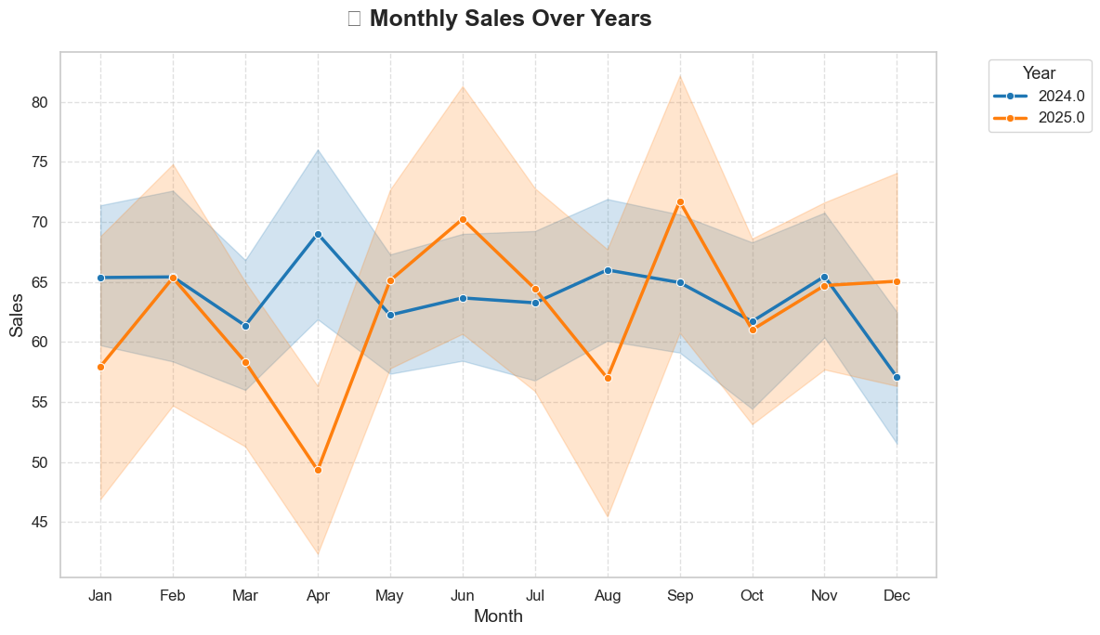
Sales over time – Python code

Slide 5
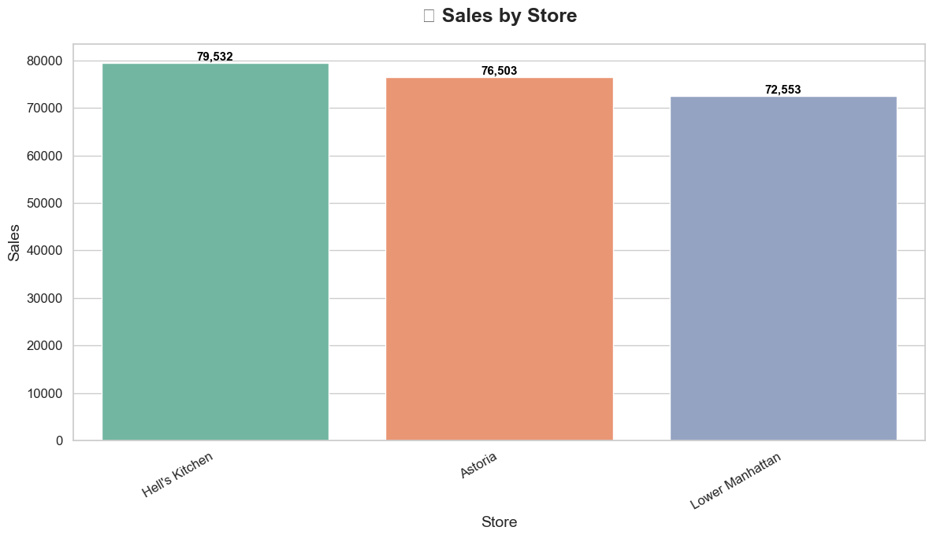
Sales by Store – used Python code(matplotlib and seaborn)

Slide 6
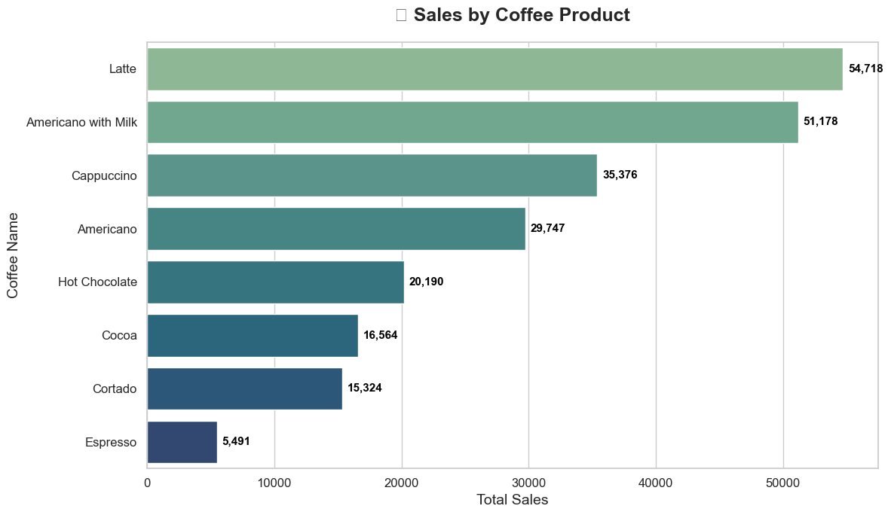
Sales by Coffee Types- Python code
Latte is the product with the highest revenue, while Expresso is the one at the bottom.

Slide 7
Monthly Sales of coffee by coffee types(python)
coffee_name | Month | Americano | Americano with Milk | Cappuccino | Cocoa | Cortado | Espresso | Hot Chocolate | Latte
0 | 1.0 | 12.0 | 42.0 | 15.0 | 8.0 | 6.0 | 1.0 | 7.0 | 18.0
1 | 2.0 | 15.0 | 27.0 | 12.0 | 6.0 | 7.0 | 1.0 | 6.0 | 20.0
2 | 3.0 | 17.0 | 44.0 | 20.0 | 13.0 | 10.0 | 3.0 | 16.0 | 28.0
3 | 4.0 | 21.0 | 27.0 | 12.0 | 9.0 | 11.0 | 1.0 | 5.0 | 19.0
4 | 5.0 | 25.0 | 29.0 | 23.0 | 16.0 | 9.0 | 6.0 | 10.0 | 26.0
5 | 6.0 | 15.0 | 17.0 | 21.0 | 7.0 | 6.0 | 7.0 | 11.0 | 26.0
6 | 7.0 | 20.0 | 21.0 | 15.0 | 16.0 | 12.0 | 7.0 | 11.0 | 30.0
7 | 8.0 | 24.0 | 24.0 | 15.0 | NaN | 14.0 | 3.0 | 4.0 | 19.0
8 | 9.0 | 24.0 | 25.0 | 16.0 | 7.0 | 9.0 | 7.0 | 12.0 | 31.0
9 | 10.0 | 18.0 | 20.0 | 11.0 | 9.0 | 8.0 | 3.0 | 15.0 | 28.0
10 | 11.0 | 18.0 | 28.0 | 16.0 | 10.0 | 11.0 | 3.0 | 14.0 | 39.0
11 | 12.0 | 22.0 | 20.0 | 13.0 | 8.0 | 11.0 | 4.0 | 16.0 | 22.0

Slide 8
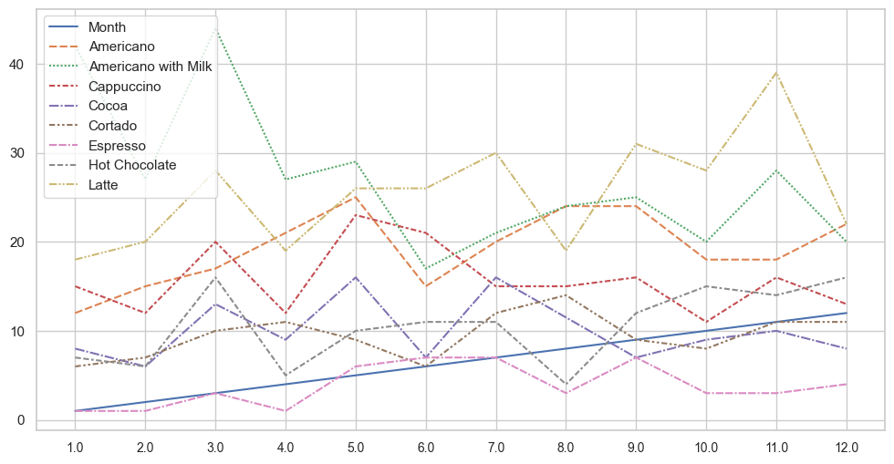
Monthly Sales of Coffee by Coffee-Types(Python)
As shown in the line chart, Americano with Milk and Latte, and Cappuccino are top selling coffee types, while Cocoa and Expresso have lowest sales. Additionally, Americano with Milk and Latte show an upward trending

Slide 9
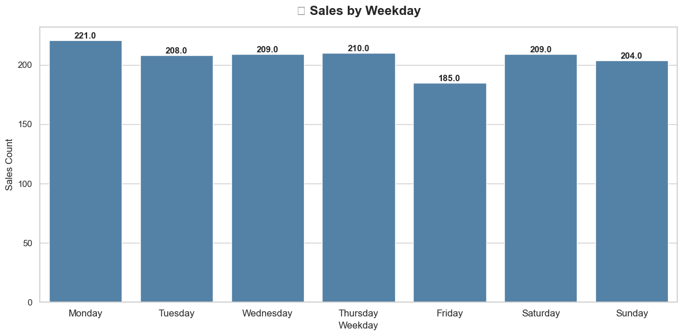
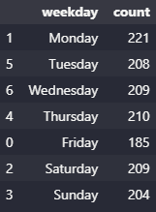
Weekly Sales or Sales by Weekday
The bar chart reveals that Monday has the highest sales of the week, while sales on the other days are relatively similar.

Slide 10
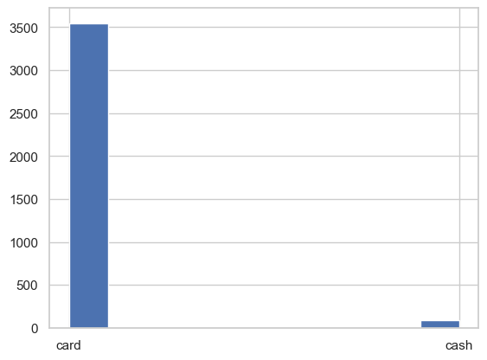
Sales by Cash or Card(python)
~92% of the transactions are from card users.

Slide 11
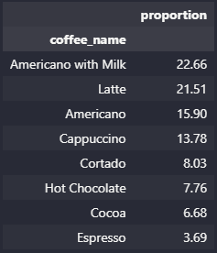
Coffee Proportions (Python)
Americano with Milk and Latte are our most popular coffee products.
In the second tier are Cappuccino and Americano ,while Cortado,Hot Chocolate,
Espresso, and Cocoa are less popular

Slide 12
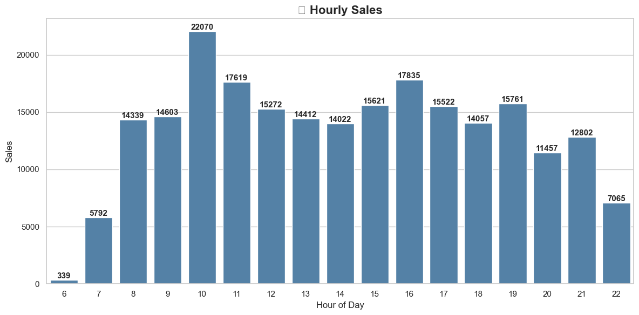
Hourly Coffee Sales (Python)
Overall, two peak hours within each day can be observed:10:00am and 4:00pm.

Slide 13
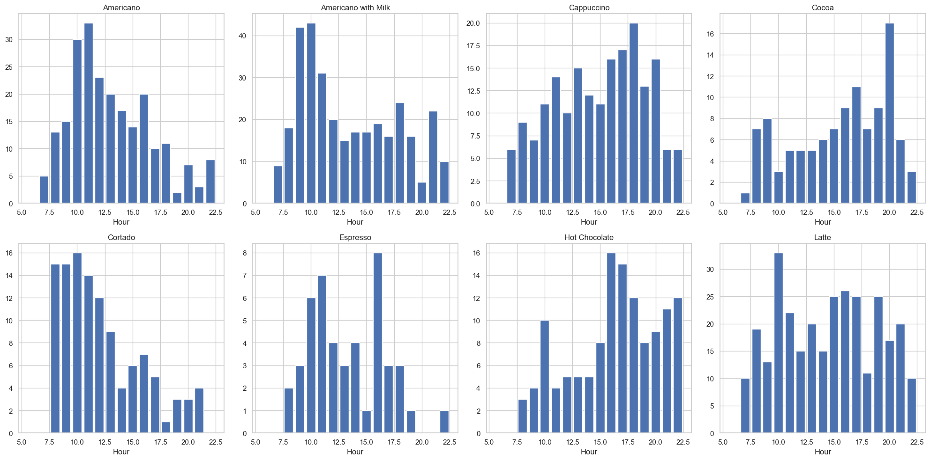
Hourly Sales by Coffee Type (Python)
The plots above illustrate the shopping traffic for each product throughout the day. Notably, all products experience a peak in traffic around 10:00 AM, with this trend being particularly pronounced for Latte. Additionally, Cappuccino, Cocoa, and Hot Chocolate tend to be more popular during the evening hours, specifically between 6:00pm and 8:00pm.

Slide 14
Conclusion
From the analysis above, we have uncovered valuable insights into customer shopping patterns on a daily and weekly basis.
We have identified the most popular coffee products and observed the shopping trends over time.
These findings are instrumental in optimizing inventory planning, designing the layout of vending machines, and determining the ideal restock times for coffee products.

